Slide 1

Data Analysis and Modeling for Public Affairs
Akshay Rathi
Agastya Teja
Devanshi Mittal
Linh Truong
24 April 2019

Slide 2
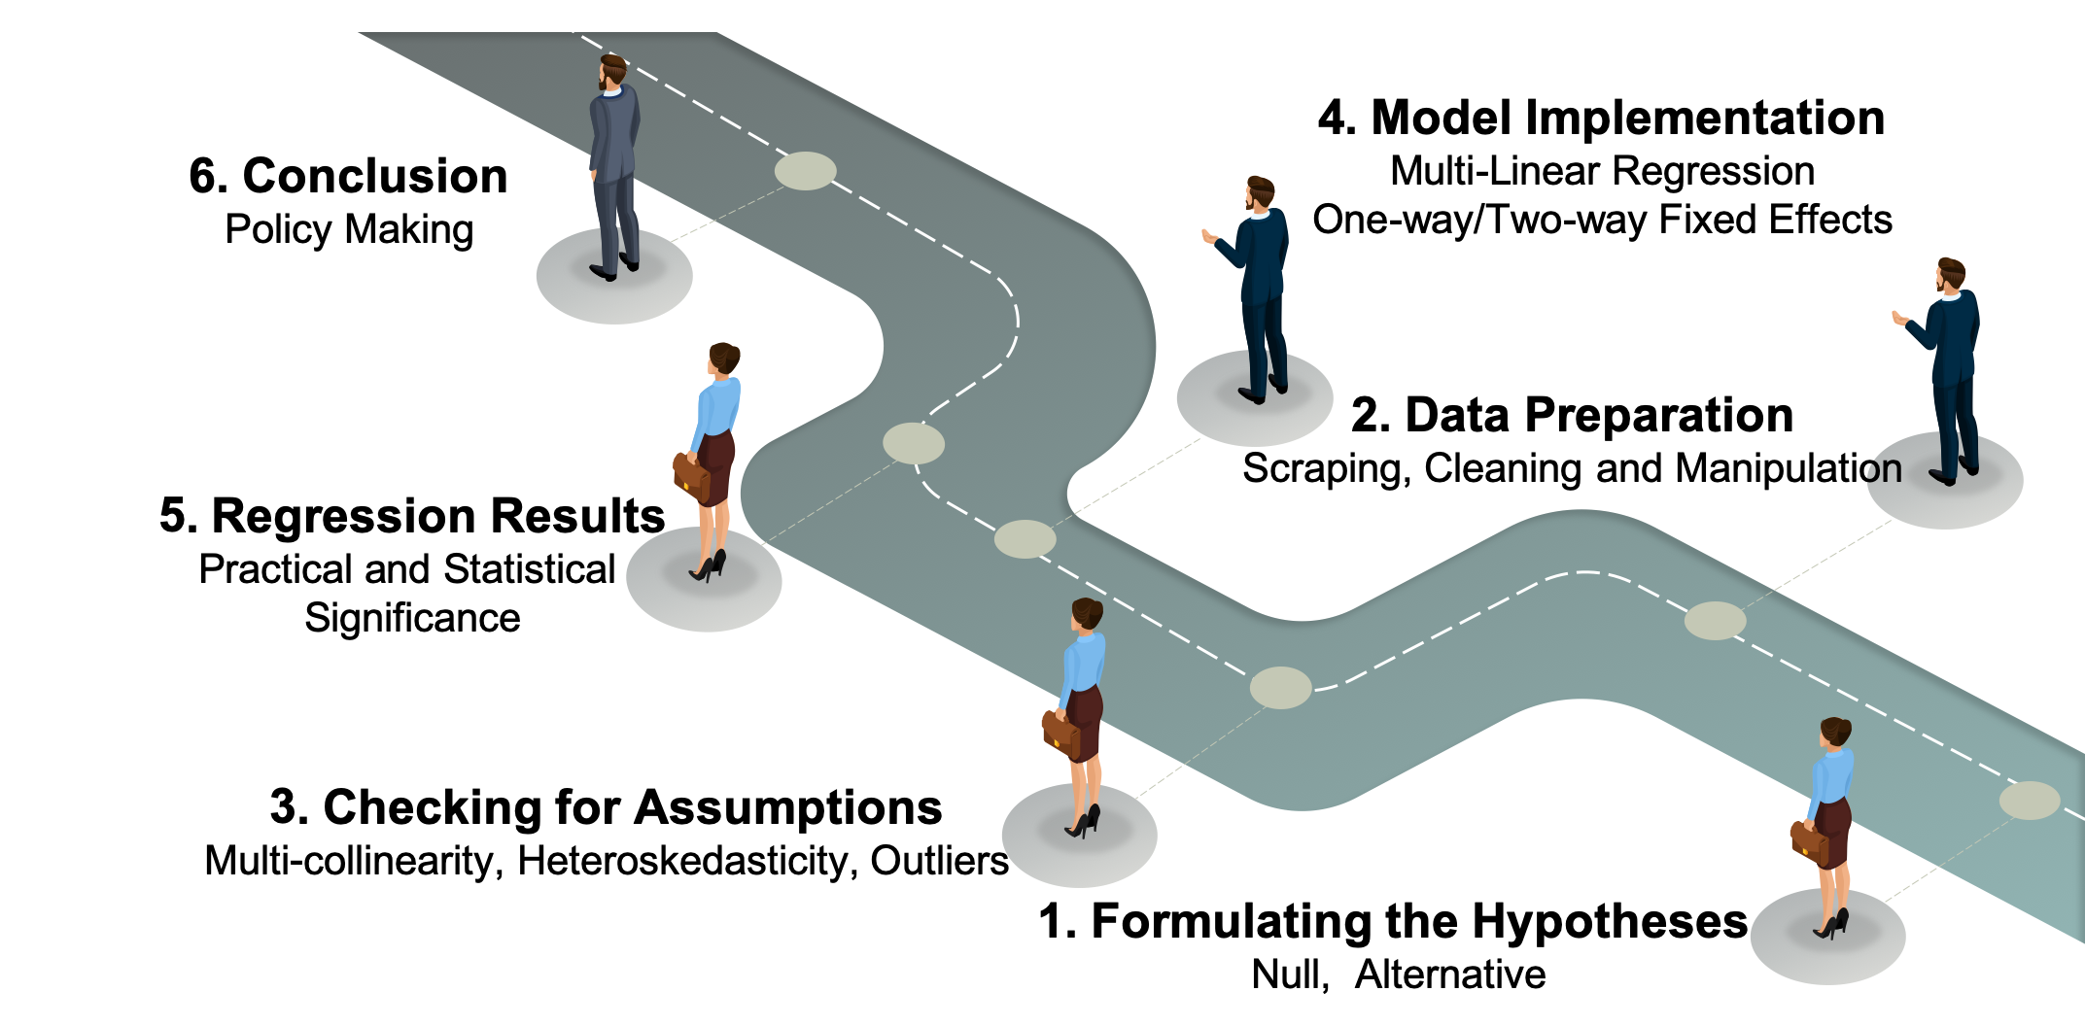
roadmap

Slide 3


introduction
The links between the government and happiness operate in both directions: what governments do, affects happiness and in turn the happiness of citizens in most countries determines what kind of governments they support.
“Increase in GDP per capita does not increase the happiness of that country" (Money can’t buy happiness!?)
?

Slide 4
DATASET
 | Predictor | How was the predictor measured?
1. | GDP per capita | Purchasing Power Parity (PPP) adjusted to constant 2011 international dollars, taken from the World Development Indicators (WDI).
2. | Healthy Life Expectancy at Birth | Constructed based on data from the World Health Organization (WHO) Global Health Observatory data repository.
3. | Social Support | National average of the binary responses (either 0 or 1) to the Gallup World Poll (GWP) question “If you were in trouble, do you have relatives or friends you can count on to help you whenever you need them, or not?”
4. | Freedom to make life choices | National average of binary responses to the GWP question “Are you satisfied or dissatisfied with your freedom to choose what you do with your life?”
5. | Generosity | Residual of regressing the national average of GWP responses to the question “Have you donated money to a charity in the past month?” on GDP per capita.
6. | Perceptions of Corruption | Average of two GWP questions: “Is corruption widespread throughout the govt or not?” and “Is corruption widespread within businesses or not?”
7. | Confidence in national govt. | Scale: 1 to 5 (No opinion – None at all – Not very much – Fair amount – Great deal)
 |  | Years – 2009 to 2018, Total Countries – 85

Slide 5
Yeah, but what about happiness?
Gallup explains that it randomly selects the respondents in each country, but takes care to ensure that the group is geographically and demographically representative of the entire population aged 15 and older. The typical sample size in each country is 1,000 people.
Survey Questions -
1. “Please imagine a ladder with steps numbered from 0 at the bottom to 10 at the top. Suppose we say that the top of the ladder represents the best possible life for you and the bottom of the ladder represents the worst possible life for you.
2. “On which step of the ladder would you say you personally feel you stand at this time, assuming that the higher the step the better you feel about your life, and the lower the step the worse you feel about it? Which step comes closest to the way you feel?”

Slide 6
AssumptionS: multi-collinearity,
heteroskedasticity
 | Predictors | VIF Scores
1. | Log GDP per capita | 18.124777
2. | Healthy Life Expectancy at Birth | 13.137312
3. | Social Support | 2.951401
4. | Freedom to make life choices | 2.641130
5. | Generosity | 2.666562
6. | Perceptions of Corruption | 3.874899
7. | Confidence in national govt. | 2.757005
8. | Country (as.factor) | 1.118087
9. | Year (as.factor) | 1.099308
Breusch-Pagan test - BP = 194.26, df = 96, p-value = 1.229e-08 (Heteroskedastic)
Removed Missing Values
Notes:
We tested three different models with one with both the variables, with GDP only and with Life expectancy only and there were no significant change in the results in all three so we decided to keep all the models.

Slide 7



Regression model
lm (Happiness ~ Independent Variables + as.factor(year) + as.factor(country))
 | Independent Variables | Coefficients | Statistical Significance
1. | Log GDP per capita | 1.196
2. | Healthy Life Expectancy at Birth | -0.039
3. | Social Support | 1.235
4. | Freedom to make life choices | 0.790
5. | Generosity | 0.474
6. | Perceptions of Corruption | -0.417
7. | Confidence in national govt. | 0.419
 | Adjusted R-squared: 0.91 F-statistic: 80.36 on 96 and 645 DF, p-value: < 2.2e-16

Slide 8
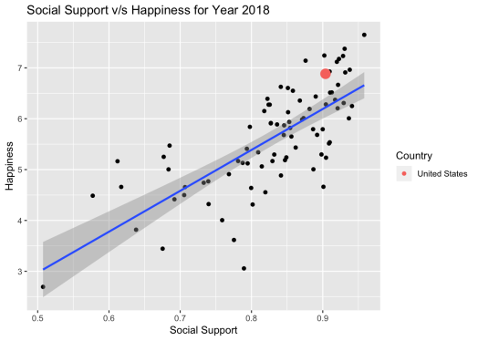
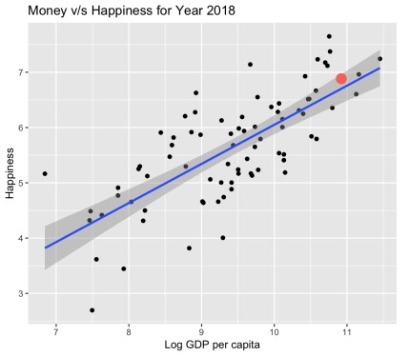
AnalyZing results
Year 2018
Investing in social support can have a bigger impact on happiness than investing in GDP growth, all other factors being constant.

Slide 9
Conclusion – Policy making
We can reject our null hypothesis and can say with 95% confidence that increase in GDP per capita does increase the happiness of that country, in turn, proving –
MONEY CAN BUY HAPPINESS!!
Suggestions -
1. Invest in community building programs which increase positive interaction among people.
2. Develop a strong economy by absorbing foreign investments, new technologies etc.
3. Increase personal freedom while maintaining public order and safety of the people.
Future Work -
1. Investigate on other psychological factors that affect happiness.
2. Investigate the definition of freedom and other factors which are highly subjective.

Slide 10
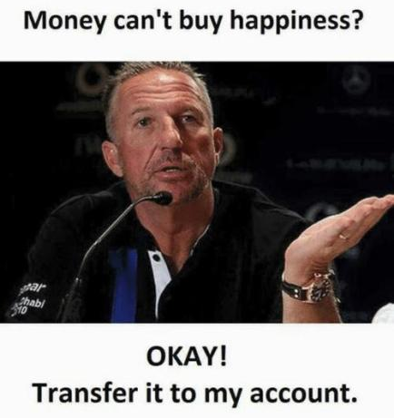
Thank you

